Slide 1

लोक वित्तीय प्रबंधन तंत्र
Public Financial Management System
Formerly Known As
CENTRAL PLAN SCHEME MONITORING SYSTEM
महालेखानियंत्रक
O/o Controller General of Accounts
वित्त मंत्रालय, भारत सरकार
Ministry of Finance, Government of India

Slide 2

About PFMS
Public Financial Management System (PFMS) also known as Central Plan Scheme Monitoring System (CPSMS) is envisaged to track the fund disbursement from Govt. of India to various levels down below under all Plan Schemes till the last level of utilization and ultimately report utilization under these schemes at different levels of implementation on a real time basis.
PFMS is a Central Sector Plan Scheme of Department of Expenditure and is being implemented by the Office of the Controller General of Accounts (CGA).
The complete technical support viz. application development, database administration, hosting of portal etc has been entrusted to NIC.

Slide 3
Objectives
Monitoring of flow of funds from Centre to the lowest level of implementation- both under SPV & Treasury route.
Reduction of float/ funds in the agencies’ bank accounts and “Just in time” provision of funds to agencies, based on floats/ funds available.
Registration of all agencies receiving funds with their bank accounts at all levels of operation/implementation.
Payment to ultimate beneficiaries through banking channel
Capturing component-wise expenditure on real time basis at all tiers of implementation, including Panchayats and villages.
Decision Support System (DSS) to all levels of programme administration (Centre, State, District & Local Government, i.e. Panchayat / Municipality)
Enhance Accountability & Transparency in public expenditure.

Slide 4
Classification of Schemes on PFMS Portal
Govt. of India Schemes
  (A)
    Central Sector Schemes
    Establishment expenditure
    Other Central Expenditure
  (B)
    Central Sponsored Schemes
    Finance Commission Grants
    Other Grants/ Loans/ Transfers
State Govt. Schemes / UT Schemes
    Linked with GoI Schemes
    State Funded Schemes

Slide 5
PFMS based Fund Flow for GoI Schemes
CS Schemes/ Other Central Exp.
CSS Schemes, Finance Commission & other Grants to State Govt.
Ministry
RBI
State Consolidated Fund
PFMS – State Treasury Integration
Central Schemes
State Schemes
PFMS
State
Treasuries
State Implementing Agency
Level 1
Central Agency
Level 1
State Implementing Agency
Level 2
Central Agency
Level 2
Vendors/ Employees/
Beneficiaries
Central Agency Level 3
PRI/ ULB
State Implementing Agency
Level 3

Slide 6
PFMS: Span of PFMS (Users of PFMS)
Central Government
Consolidated Fund of India
Drawing and Disbursing officer
IFD
Program Division
Pay and Account Officer/Pr AO
State SPV
Pvt. Sector Companies/NGOs/etc
SPV Route (Implementing agencies) Local Government
State Government treasury
Central Govt. Scheme
District SPV
Reserve Bank of India
Block SPV
Consolidated Fund of State
State Govt. Scheme
Panchayat
Village
State Government
Beneficiary

Slide 7
Automation of Data Exchange
PFMS
External System/Database
SYSTEM DATA BASE
PFMS
SFTP Server
PFMS

Slide 8
Achievements: Bank Interface
Total 250* Banks Integrated with PFMS
  All Nationalised Banks
  Major Private Sector Banks
  All Regional Rural Banks / Cooperative Banks
  India Post
IFSC code to 1.45 Lakh Post Offices out of 1.5 lakh

Slide 9


PFMS-CBS interface
PFMS
Bank
PFMS BizTalk Server
Leased Line Connectivity
Bank SFTP Server
Internet
PFMS–CBS INTEGRATION
PFMS Integration Server
of Bank
PFMS Appln. Server
Bank CBS System

Slide 10
Account Validation Response
PFMS BizTalk Server
Bank SFTP Server
PFMS Application
PFMS–CBS INTEGRATION
Cycle Period
Near Real Time
PFMS Integration Server
of Bank
Confirmation of Account Validation to Agencies
Bank CBS System

Slide 11

Daily Transaction Data
PFMS Integration Server of Bank
Bank SFTP Server
PFMS BizTalk Server
Cycle Period
End of Day
PFMS–CBS INTEGRATION
Bank CBS System
Transaction by User
PFMS Application

Slide 12
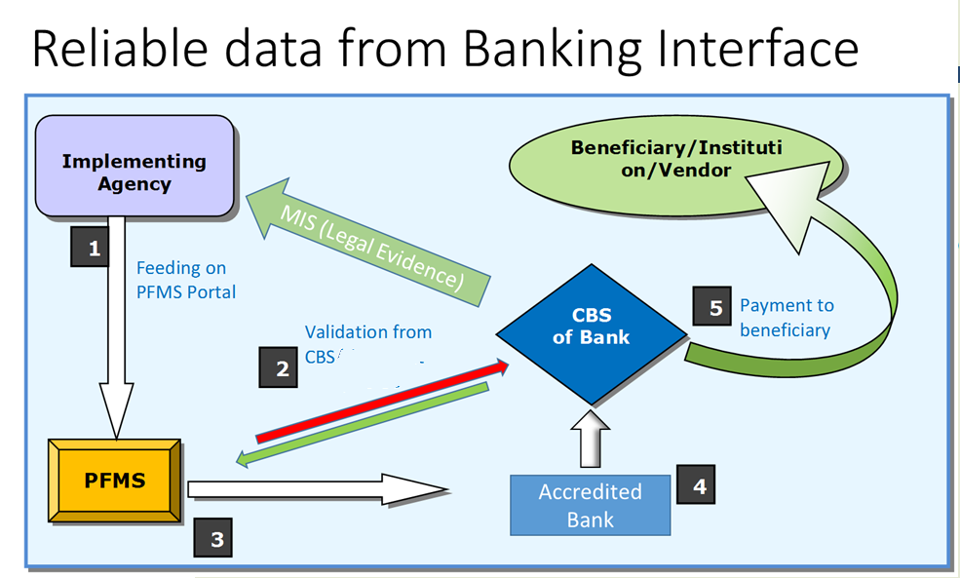

Slide 13
Modules Available
Agency Management
User Management
Fund Management
Vendor Management
Expenditure Management
Advance and Settlement
Transfer to lower level agencies
Intra Bank Fund Management

Slide 14
Schemes used by Colleges and Universities
0875 – University Grants Commission (Other Central Exp) (0873CU/0874DU)
9830 – National Fellowship for Higher Education of ST Students
0961 – Rajiv Gandhi National Fellowship for SCs SJE
1338 – Maulana Azad National Fellowship for Minority Students
9170 – Rashtriya Uchchatar Shiksha Abhiyan (Linked State Scheme)
9230 – NSS (Central Scheme) – Funded by the Universities
1023 – SERB – Funded by DSTSERB
0877 – ICSSR – Funded by ICSSR
0265 – Atmospheric Change (Central Scheme) – Funded by Central Govt
0150 – Biotechnology Research and Development – Funded by Central Govt
1817 – S&T Institutional and Human Capacity Building – Funded by Central Govt
1596 – Alliance and R & D Mission – Funded by Central Govt
1594 – DISHA – Funded by Central Govt
0265 – (9986) Research and Development for Conservation and Development – Central Govt

Slide 15
Common mistakes by Institutions
Single Account for All schemes
  This will lead to inflated float
Account not in the name of institution
  Funding agency will be unable to transfer funds
  Institution has to update KYC in the bank
  And inform me by mail with a copy of passbook (cpsms.f@gmail.com)
Wrong selection of funding agency
  Institution to inform me to correct and suggest the right path

Slide 16
TEST Server URL 164.100.129.32
Password will be root@1234 or root@123
Child Agency ADM - DHSUJJADM
Parent Agency ADM - RJGA00000180
Parent Agency Unique Code - SHSMP
Rahul2012/Damujjain - AgencyDO
Drmilind / - AgencyDA
-----
Agency DO : Rahul2012
Parent Agenc Code : dhswardha
Agency ADM as parent : dhswardhamaker

Slide 17
Thank you!

Slide 18
Microsoft KAIZALA
NLIUAD
OBHDOME

